Slide 1
International Islamic University Chittagong
Department of Computer and Communication Engineering
Course Code: CCE-3507
Course Title: System Analysis, Design and Development
Abu Raihan Anchari Miskat
Adjunct Faculty
Dept. of CCE, IIUC

Slide 2
Feasibility study
A feasibility study is an assessment of a project's practicality to determine if it's likely to succeed before significant resources are invested.
It objectively evaluates a project's potential by examining its goals, the required resources, financial aspects, and potential challenges to identify strengths, weaknesses, opportunities, and risks.
A feasibility report is a document that assesses the viability and practicality of a proposed project, idea, or solution to determine if it is worth pursuing. It analyzes various factors like technical, financial, market, operational, and legal aspects, identifying challenges, costs, and benefits.

Slide 3
Types of Feasibility study
Technical feasibility: It is focused on gaining an understanding of the present technical resources of the organization and their applicability. It is an evaluation of the hardware and software and how it meets the need of the proposed system.
Economic feasibility: The purpose of it is to determine the positive economic benefits to the organization that the proposed system will provide. It includes quantification and identification of all the benefits expected. This assessment typically involves a cost/ benefits analysis. Economic feasibility is also called cost-benefit analysis.
Operational Feasibility: It refers to the measure of solving problems with the help of a new proposed system. It helps in taking advantage of the opportunities and fulfills the requirements as identified during the development of the project.
More: Schedule feasibility , Political feasibility, Legal Feasibility

Slide 4
costs and benefits
Development costs: Development costs are those tangible expenses that are incurred during the creation of the system, such as salaries for the project team.
Operational costs: Operational costs are those tangible costs that are required to operate the system, such as the software licensing fees.
Tangible benefits: include revenue that the system enables the organization to collect, such as increased sales, reduction of costs, etc.
Intangibles: Intangible costs and benefits are more difficult to incorporate into the economic feasibility analysis because they are based on intuition and belief rather than on “hard numbers”.

Slide 5
One-Time Costs: Associated with project start-up, initiation and development
  * System development
  * New hardware and software purchases
  * User training
  * Site preparation
  * Data or system conversion
Recurring (Operational) Costs: Associated with on-going use of the system
  * New human resource costs
  * Application software maintenance
  * Incremental data storage expense
  * Incremental communications
  * New software and hardware releases
  * Consumable supplies

Slide 6
STEPS in ECONOMIC FEASIBILITY ANALYSIS
Identify Costs and Benefits
Assign Values to Costs and Benefits
Determine Cash Flow
Assess Project’s Economic Value

Slide 7
STEPS in ECONOMIC FEASIBILITY ANALYSIS
Identify Costs and Benefits
Assign Values to Costs and Benefits
Determine Cash Flow
Assess Project’s Economic Value

Slide 8
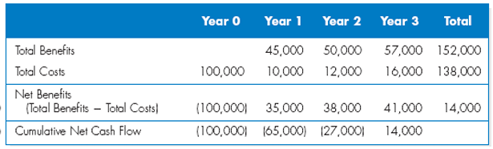
Cash flow analysis
Cash flow analysis is the process of reviewing a business's or project's cash inflows (money coming in) and outflows (money going out) over a specific period to assess its financial health, liquidity, and ability to meet obligations.

Slide 9
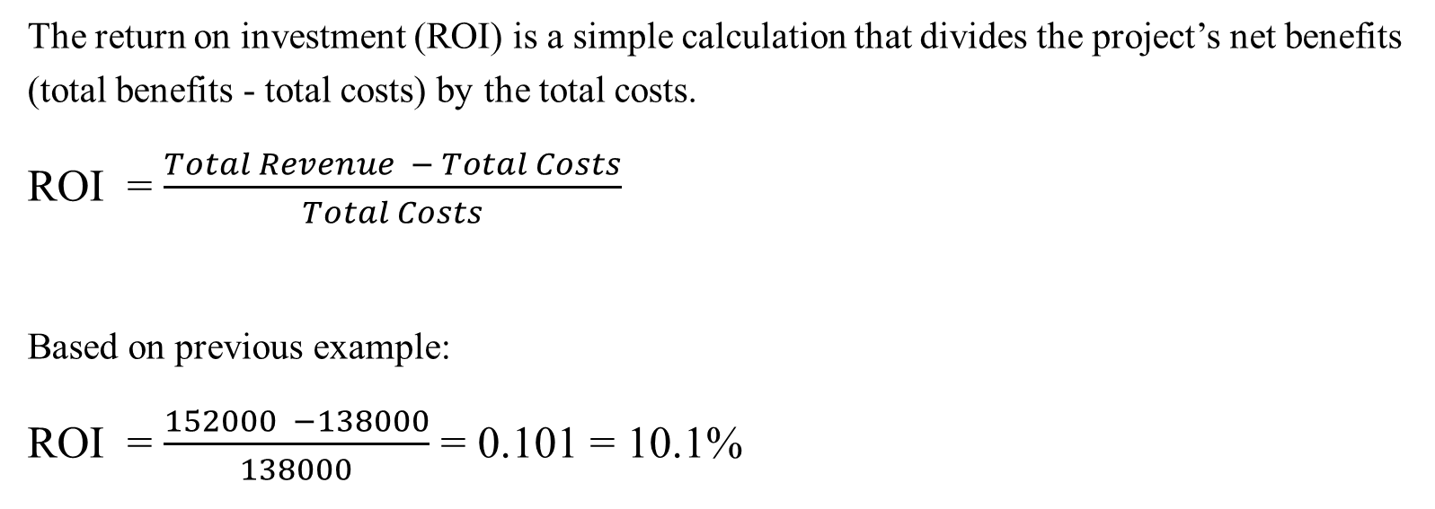
Return on Investment
The return on investment (ROI) is a simple calculation that divides the project’s net benefits (total benefits - total costs) by the total costs.
ROI = $\frac{Total Revenue − Total Costs}{Total Costs}$
Based on previous example:
ROI = $\frac{152000 −138000}{138000}$ = 0.101 = 10.1%

Slide 10
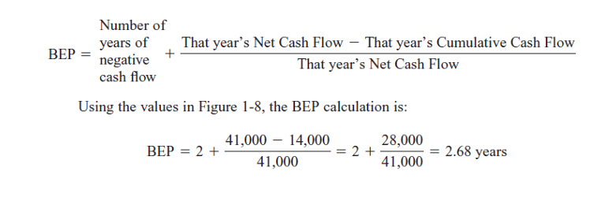
Break-Even Point
The break-even point (also called the payback method) is defined as the number of years it takes a firm to recover its original investment in the project from net cash flows.
Based on last example:

Slide 11

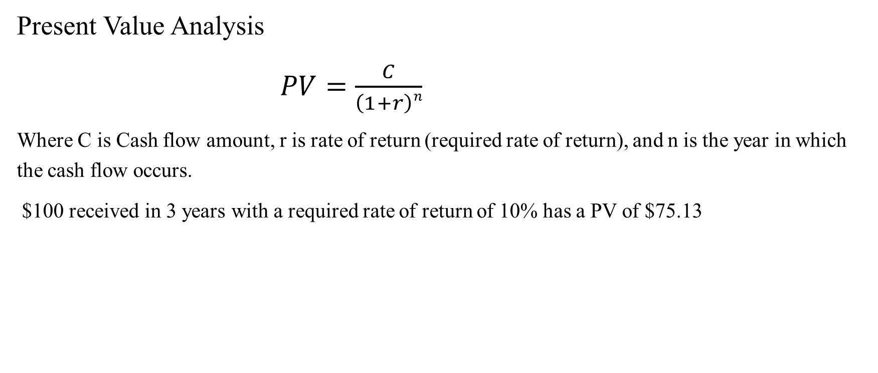
Discounted Cash Flow Technique
Present Value Analysis
              $PV=\frac{C}{\left(1+r\right)n}$
Where C is Cash flow amount, r is rate of return (required rate of return), and n is the year in which the cash flow occurs.
$100 received in 3 years with a required rate of return of 10% has a PV of $75.13

Slide 12
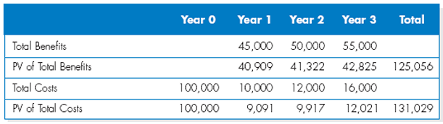

Net Present Value (NPV):
$$NPV = ∑ PV of Total Benefits − ∑PV of Total Costs$$
        = $125,056 - $131,029 = ($5,973)
The present value of the projected benefits and costs have been calculated using a 10% required rate of return.

Slide 13
A business case
The term business case refers to the reasons, or justification, for a proposal.
A business case is a formal document that provides the justification for a proposed project, investment, or initiative by outlining the problem it aims to solve, the benefits it will bring, the costs involved, and the potential risks.
A business case should be comprehensive, yet easy to understand. It should describe the project clearly and estimate the project’s financial impact.

Slide 14
A business case
The business case should answer questions such as the following:
  Why are we doing this project?
  What is the project about?
  How much will it cost and how long will it take?
  What is the return on investment and payback period?
  What are the risks of doing the project?
  What are the risks of not doing the project?
  How will we measure success?
  What alternatives exist?

